Slide 1
أكـــــاديميــــة طــــويـــق
Linear Algebra for Machine Learning

Slide 2
Introduction to Linear Algebra
Fundamentals and Applications
By: Dr. Afshan Hashmi

Slide 3
Course Objectives:
Recall and explain the relationship between machine learning concepts and mathematical constructs like vectors and matrices.
Course Learning Outcomes:
Recall how machine learning and vectors and matrices are related
Interpret how changes in the model parameters affect the quality of the fit to the training data

Slide 4
The Role of Linear Algebra in Machine Learning
Machine learning algorithms rely heavily on linear algebra. Vectors and matrices provide a concise and efficient way to represent data and perform the mathematical operations for many Machine Learning models. Let's explore how these mathematical tools are used:
Data Representation
Model Training and Computation
Optimization (Gradient Descent)
Dimensionality Reduction
Distance and Similarity Measures

Slide 5

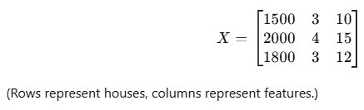
1. Data Representation
Feature Vectors: Each data point in a machine learning dataset can be represented as a vector of features. Think of it as a list of characteristics describing that data point.
  Example: A house price prediction model may use a feature vector x = [area, bedrooms, age] = [1500, 3, 10]
Datasets as Matrices: When we have multiple data points, these feature vectors are organized into a matrix. Each row of the matrix represents a single data point (or instance), and each column represents a specific feature.
  Rows = Data samples
  Columns = Features
  Example: A dataset with n samples and m features is represented as an n × m matrix.

Slide 6
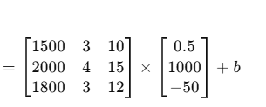
2. Model Training and Computation
Linear Regression: This model predicts a value based on a linear combination of the features. Using matrix multiplication to calculate the predictions
Model: y = Xw + b
X: Feature matrix
w: Weight vector
b: Bias
y: Predicted output
Y

Slide 7
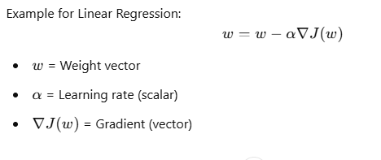
3. Optimization (Gradient Descent)
Machine learning models learn by adjusting their parameters (like w and b in linear regression). Gradient descent is a common algorithm for this, and it relies on vector calculus.
Process: The gradient of a loss function (which measures how well the model is performing) is calculated. This gradient is a vector that points in the direction of the steepest ascent. We move against the gradient (downhill) to find better parameter values.

Slide 8
4. Dimensionality Reduction: Simplifying Complex Data
Imagine you're trying to understand a complex system, like the factors influencing a city's air quality. You might have dozens of measurements: pollution levels, traffic volume, weather conditions, industrial activity, and so on. Analyzing all these factors at once can be overwhelming and computationally expensive. This is where dimensionality reduction comes in.
What is Dimensionality Reduction?
Dimensionality reduction is a technique that aims to simplify high-dimensional data by reducing the number of features (or dimensions) while preserving the essential information. This simplification can make data easier to visualize, process, and analyze, and it can also help prevent overfitting in machine learning models. Techniques like:
Principal Component Analysis (PCA) use eigenvectors and eigenvalues (concepts from linear algebra) to reduce the number of features while preserving important information. This is useful for dealing with high-dimensional data.
Singular Value Decomposition (SVD): Another powerful technique for dimensionality reduction is Singular Value Decomposition (SVD). Unlike PCA, which works on the covariance matrix of the data, SVD directly decomposes the data matrix itself.

Slide 9
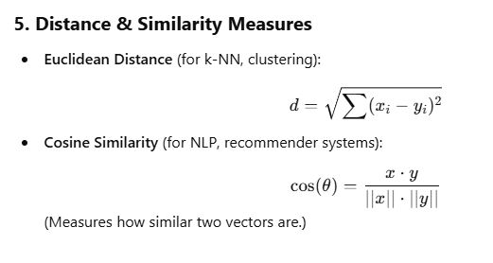
5. Dimensionality Reduction: Simplifying Complex Data
5. Distance and Similarity Measures
Many machine learning algorithms rely on calculating distances or similarities between data points.
Euclidean Distance: A common way to measure the straight-line distance between two points (vectors).
Cosine Similarity: Measures the angle between two vectors, indicating how similar their directions are. This is often used in natural language processing and recommendation systems.

Slide 10
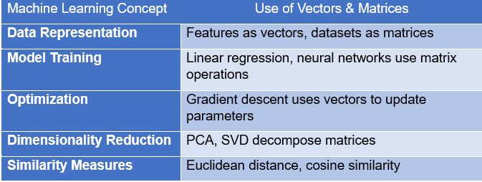
Summary

Slide 11
How Changes in Model Parameters Affect Fit Quality in Machine Learning
Model parameters (such as weights, biases, and hyperparameters) directly influence how well a model fits the training data. Here’s how different parameter changes impact model performance:
Equation of Linear Regression
Y= wX + b
    w(weight or slope): Controls how steep the line is.
    b(bias or intercept): Shifts the line up or down.
Effect of Changing Parameters
Increasing w: Steeper slope, which can lead to overfitting.
Decreasing w: Flatter slope, which may cause underfitting.
Changing b: Moves the regression line up/down but does not affect the slope.

Slide 12
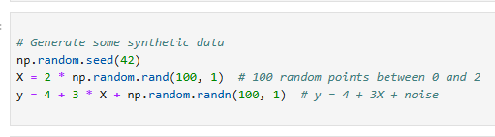

How Changes in Model Parameters Affect Fit Quality in Linear Regression
.
 | Synthetic Data Generation: We generate 100 random points for XX between 0 and 2. The target yy is generated using the equation y=4+3X+noisey=4+3X+noise, where the noise is added to simulate real-world data.
 | Linear Regression Equation: The function linear_regression(X, w, b) computes the predicted yy values using the equation y=wX+by=wX+b.

Slide 13
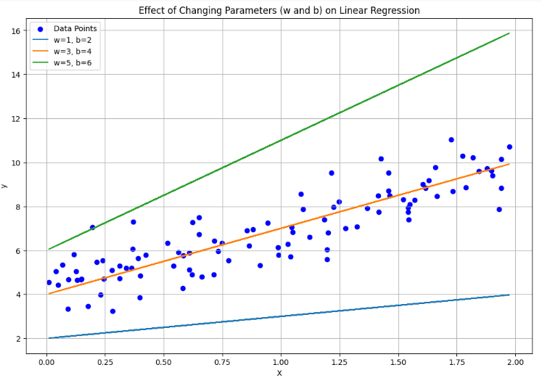
How Changes in Model Parameters Affect Fit Quality in Linear Regression
.
Effect of Changing Parameters:
Increasing w: The slope of the regression line becomes steeper. If weight is too large, the line may overfit the data.
Decreasing w: The slope becomes flatter. If weight is too small, the line may underfit the data.
Changing b: The intercept shifts the line up or down without affecting the slope.
  The original data points scattered in blue.
  Three regression lines corresponding to different values of w and b.

Slide 14
Gradient Descent and Learning Rate Effect
.
The learning rate is a crucial parameter in gradient descent. It controls the size of the steps you take downhill:
High Learning Rate: If the learning rate is too high, you might take large steps and overshoot the lowest point, bouncing around and never settling at the optimal solution. This can lead to instability and prevent convergence.
Low Learning Rate: If the learning rate is too low, you'll take tiny steps, and it will take a very long time to reach the bottom of the valley. The training process will be very slow.
Optimal Learning Rate: A properly tuned learning rate allows the network to converge efficiently to a good solution. It's a balancing act – large enough to make progress but small enough to avoid overshooting.
In summary: Training a neural network involves carefully balancing the weights and biases to avoid overfitting and underfitting, and tuning the learning rate in gradient descent to ensure efficient convergence. It's a process of finding the sweet spot where the network learns the underlying patterns in the data without memorizing noise.

Slide 15
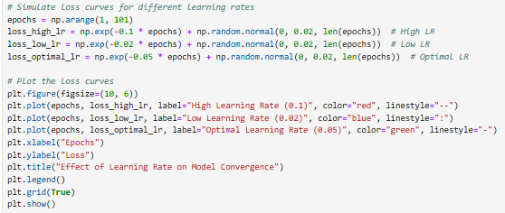
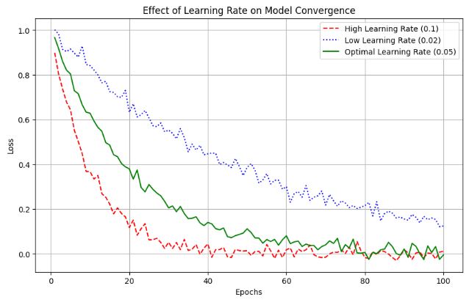
Gradient Descent and Learning Rate Effect
.
Key Takeaways
High Learning Rate: Fast but unstable convergence.
Low Learning Rate: Slow but stable convergence.
Optimal Learning Rate: Balances speed and stability for efficient convergence.

Slide 16
Regularization: Impact on Overfitting & Underfitting
.
Types of Regularization
L1 (Lasso): Shrinks some weights to zero → Feature selection.
L2 (Ridge): Shrinks weights but doesn’t remove them → Prevents overfitting.
Dropout (for neural networks): Randomly drops neurons to improve generalization.
Effect of Regularization Strength (λ\lambda)
No regularization → Overfits.
Moderate regularization → Generalizes well.
Too much regularization → Underfits.

Slide 17
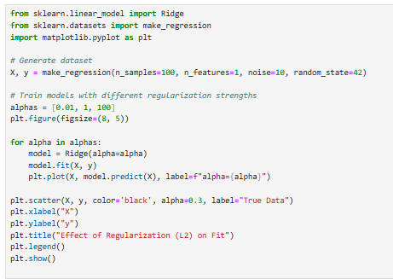
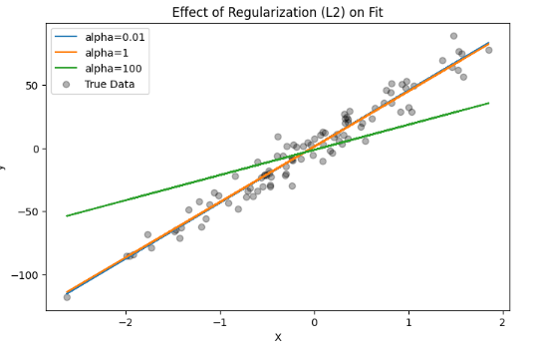
Effects of L2 Regularization on fit
.
No regularization (small λ\lambda) → Overfits.
Medium regularization → Best fit.
High regularization (large λ\lambda) → Underfits.

Slide 18
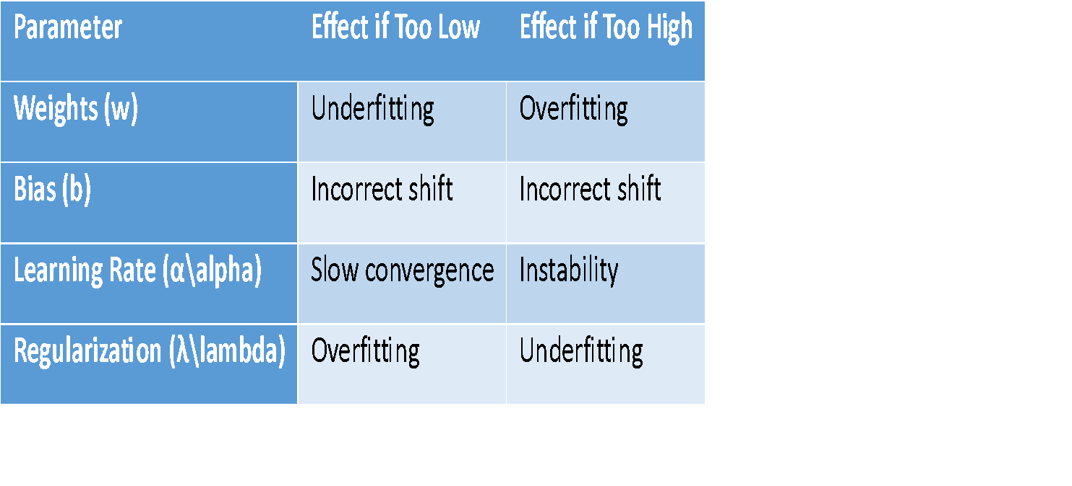
Overall Effects of Parameters on Fit

Slide 19

Practical Implementation
Click here for the code

Slide 20

















الشراكات العالمية

Slide 21
شــــــكــــرًا لكــــــم
THANK YOU

